Slide 1
Curves and Splines
Interpolating in round-about ways
Programming – Maths for Games

Slide 2
Contents
Bezier Curves
Hermite Curves
Splines
Cardinal Splines
Catmull-Rom Splines

Slide 3




Interpolation
Interpolation is the process of finding new unknown values that are between known existing values
Linear Interpolation is typically used to Interpolate between two values
For example, between two points
But Linear Interpolation interpolates in a straight line between the two values
What if we wanted to smoothly interpolate in a curve between two values?
Different curve methods exist that produce curves with various constraints, which we will now look at…
$$result=a\left(1−t\right)+bt$$
$$result=a+(b−a)t$$
$$result=a+vt$$
Different Linear Interpolation methods where $t$ is a value between 0 and 1, $a$ and $b$ are points, and $v$ is an offset vector

Slide 4
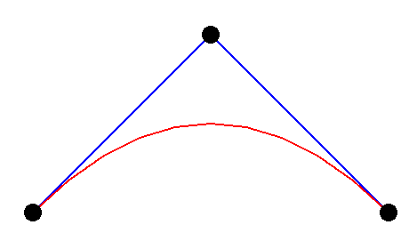




Bezier Curves
Bezier curves are basically compound linear interpolations
They are created via a series of linear interpolations
They represent parametric curves
They are created by interpolating between a collection of control points
2 points would be the same as a Linear Interpolation
3 points is a Quadratic Bezier Curve
4 points is a Cubic Bezier Curve
Let’s look at how we can implement a Quadratic Bezier Curve…
$$p1$$
$$p2$$
$$p0$$
Here the red line represents a Quadratic Bezier Curve between points $p0$ and $p2$

Slide 5
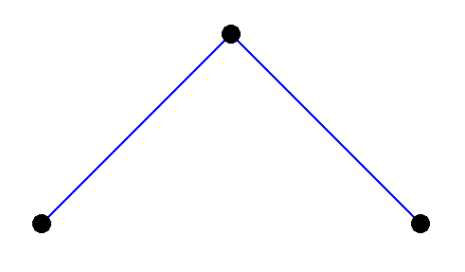
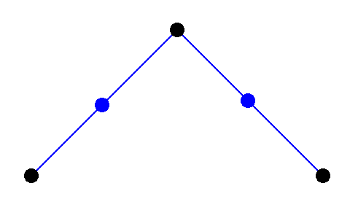









Bezier Curves
To begin with we start with 3 points, $p0$, $p1$ and $p2$, and interpolation scale $t$
The interpolation scale is the same as that used in the previous Linear Interpolations session
We then perform linear interpolations between:
$p0$ and $p1$ to create $q0$
$p1$ and $p2$ to create $q1$
Each interpolation uses the same $t$ value
$$p1$$
$$p0$$
$$p2$$
$$p1$$
$$q0$$
$$q1$$
$$p0$$
$$p2$$

Slide 6
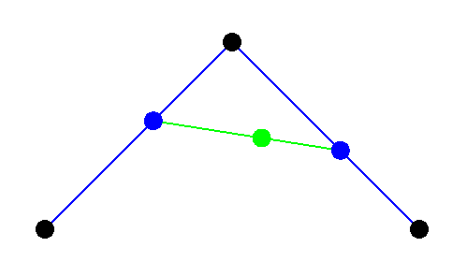
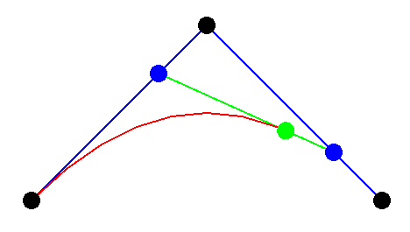






Bezier Curves
We then interpolate between $q0$ and $q1$ using the same $t$ value
The result of this interpolation is the actual interpolated Quadratic Bezier Curve value!
If we were to plot this interpolated result’s movement it would create a curve
$$p1$$
$$q0$$
$$q1$$
$$p0$$
$$p2$$

Slide 7
Simple Code Example
Quadratic Bezier Curves can be implemented in a few ways, but a simple method is to make use of a linear interpolation method
Vector2 lerp(Vector2 a, Vector2 b, float t) {
return a * (1 - t) + b * t;
}
Vector2 quadraticBezier(Vector2 a, Vector2 b, Vector2 c, float t) {
// lerp from the first point to the second
Vector2 mid1 = lerp(a, b, t);
// lerp from the second point to the third
Vector2 mid2 = lerp(b, c, t);
// return the lerp from the two intermediate points
return lerp(mid1, mid2, t);
}

Slide 8
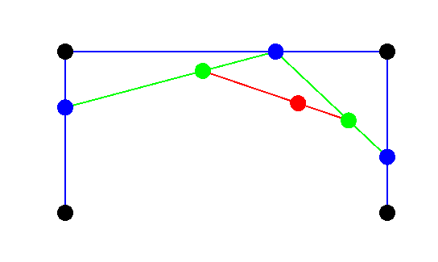










Cubic Bezier Curves
Cubic Bezier Curves using 4 control points can be implemented in the same manner
Interpolate $p0$to $p1$for $q0$
Interpolate $p1$to $p2$for $q1$
Interpolate $p2$to $p3$for $q2$
Interpolate $q0$to $q1$for $r0$
Interpolate $q1$to $a2$for $r1$
Interpolate $r0$to $r1$for the actual result
$$p1$$
$$q1$$
$$p2$$
$$q0$$
$$r0$$
$$r1$$
$$q2$$
$$p0$$
$$p3$$

Slide 9
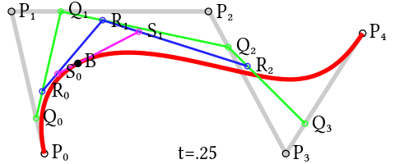
Bezier Curves
Although the previous methods seemed straight forward, they become quite cumbersome when dealing with Bezier Curves of higher order, meaning more than 4 control points
That’s right, Bezier Curves can have more than just 3 or 4 control points!
Various algorithms exist that can implement higher order Bezier Curves
The de Casteljau algorithm is a method that uses recursive iteration to find the interpolated point within any number of control points

Slide 10
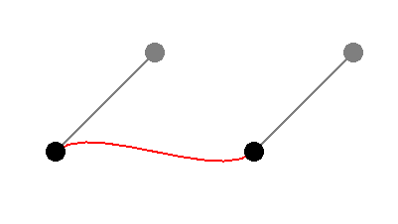




Hermite Curves
Hermite Curves are another way to represent parametric curves
They use control points, like Bezier Curves, and tangents to control the orientations of the curve
Unlike a Bezier Curve, a Hermite Spline will pass through each control point
Each control point along the curve has a matching tangent vector that is used to describe the direction of the curve at that control point
The curve is built from a weighted sum of the control points, tangents and a set of basis functions
$$tangentA$$
$$tangentB$$
$$controlPointA$$
$$controlPointB$$
Here the red line represents a Hermite Curve between the two control points

Slide 11
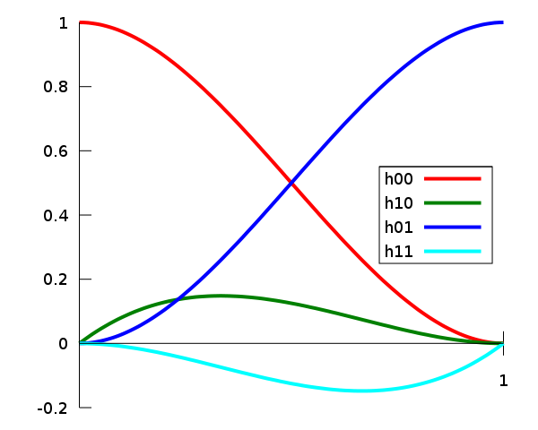

Hermite Basis Functions
There are 4 basis functions that define how much each control point and tangent effects the curve across the duration of the interpolation scale $t$
Each function is calculated based on the scale $t$ and then multiplied against its corresponding control point or tangent, then summed together to calculate the exact position along the curve for $t$:
h00 is for the first control point
h01 is for the second control point
h10 is for the first tangent
h11 is for the second tangent

Slide 12

Hermite Basis Functions
$$h00(t)={2t}^{3}–{3t}^{2}+1$$
$$h01(t)=−{2t}^{3}+{3t}^{2}$$
$$h10(t)=t^{3}–{2t}^{2}+t$$
$$h11(t)=t^{3}–t^{2}$$

Slide 13

Code Example
The following code could be used to calculate the 4 basis functions and the final interpolated result along the curve based on interpolation scale $t$
Vector2 hermiteCurve(Vector2 point0, Vector2 tangent0, Vector2 point1, Vector2 tangent1, float t) {
// calculate t-squared and t-cubed
float tsq = t * t;
float tcub = tsq * t;
// calculate the 4 basis functions
float h00 = 2 * tcub - 3 * tsq + 1;
float h01 = -2 * tcub + 3 * tsq;
float h10 = tcub - 2 * tsq + t;
float h11 = tcub - tsq;
// return the combined result
return h00 * point0 + h10 * tangent0 + h01 * point1 + h11 * tangent1;
}

Slide 14
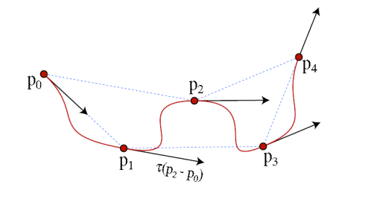
Splines
Splines are complex curves made up of many control points which the curve may or may not pass through
Rather than define a single curve segment they define a long curling line made up of many curves
Various types of Splines exist, such as:
Cardinal Splines
Catmull-Rom Splines

Slide 15

Cardinal Splines
Cardinal Splines are a subset of Hermite Curves, using the same method for calculating each curve segment
In a cardinal spline, you start with just control points and calculate the tangents for each control point, rather than setting them explicitly
The tangent $t_{n}$ at each control point ${cp}_{n}$is calculated by:
$$t_{n}=(1−c)({cp}_{n+1}−{cp}_{n−1})$$
Where $c$ is a constant value used to control the tightness of the curve
A $c$ of 1 would mean the tangents are zeroed out and do not effect the Hermite Curve calculations

Slide 16

Catmull-Rom Splines
Catmull-Rom Splines are yet a further subset of cardinal splines
In a Catmull-Rom Spline the constant value $c$ is simply set to 0
This means that each tangent $t_{n}$ at control point ${cp}_{n}$ is set to:
$$t_{n}={cp}_{n+1}−{cp}_{n−1}$$
Catmull-Rom Splines are commonly used in Camera animations
They typically create a smooth interpolation between the control points, and are guaranteed to hit the control points

Slide 17
Summary
Calculating curves is the same as calculating a standard Linear Interpolation, exception that the resulting value follows a curve between control points
Various methods for calculating curves and splines exist
Bezier Curves
Hermite Curves
Cardinal Splines
Catmull-Rom Splines

Slide 18
Further Reading
Dunn, F, Parberry, I, 2011, 3D Math Primer For Graphics And Game Development, 2nd Edition, CRC Press​
Lengyel, E, 2012, Mathematics for 3D Game Programming and Computer Graphics, 3rd Edition, CENGAGE Learning​
Wikipedia, Cubic Hermite Spline, https://en.wikipedia.org/wiki/Cubic_Hermite_spline

